Slide 1

“JOB SEARCH APPLICATION”
Task - 2

Slide 2

Job Search Application
A Job Portal application is a place where users can search and apply for job openings. In the same application, the recruiters can post job details and seek applicants. The app is quite beneficial for both applicants and recruiters.
au910020104003 |  | CC2
au910020104044 |  | CC2
 |  | CC2
LMS Username
Name
Batch
AJITH KUMAR K
SUBHASRI M
au910020104304
GANESH KUMAR C

Slide 3

Task-2
Evaluation Metric:
Component Efficiency:
Evaluate the organization of UI components for easy modification without affecting others.
API Integration Quality:
Confirm correct API configuration, assess API call efficiency, and ensure robust error handling.
Data Rendering:
Ensure accurate and consistent rendering of API responses across different components.
User Engagement:
Monitor user registrations, logins, and overall activity to gauge and enhance user engagement.
Performance and Responsiveness:
Evaluate page load times and mobile responsiveness for a smooth and responsive userexperience.
Feedback, Security, and Compliance:
Collect user feedback, conduct security assessments, and verify compliance with regulations.

Slide 4
Step-Wise Description
Project Setup:
Install Java Development Kit (JDK),Install an Integrated Development Environment (IDE),Create a Database Schema
Frontend Development
Design HTML Pages:
Design HTML pages for the user interface using HTML and CSS.
Create pages for user registration, login, job listing, etc.
Implement JSP Pages:
Use JSP for dynamic content rendering.
Embed Java code in JSP pages to interact with the backend.
Component Structure:
Organize components in a folder structure.Create components such as JobList, JobItem, and ErrorHandler.
API Integration:
Set up an api.js file for API calls with a defined base URL.Implement fetchJobs to retrieve job data from the API.

Slide 5
TASK SUMMARY
For the frontend development our job search application, several frameworks and tools can enhance the user interface and streamline the development process.JavaScript, coupled with jsp and servlet, facilitates dynamic content and simplifies DOM manipulation and event handling.
In summary, these frameworks and tools collectively contribute to creating a responsive, visually appealing, and user-friendly frontend for your job search application, enhancing both the development process and the end-user experience.
Integration of these components takes place in the main App.js file to facilitate their display within the application. Ensuring the security of API calls is a key focus, incorporating measures such as HTTPS implementation, authentication mechanisms, encryption for sensitive data, and a commitment to regular updates to address potential vulnerabilities.

Slide 6
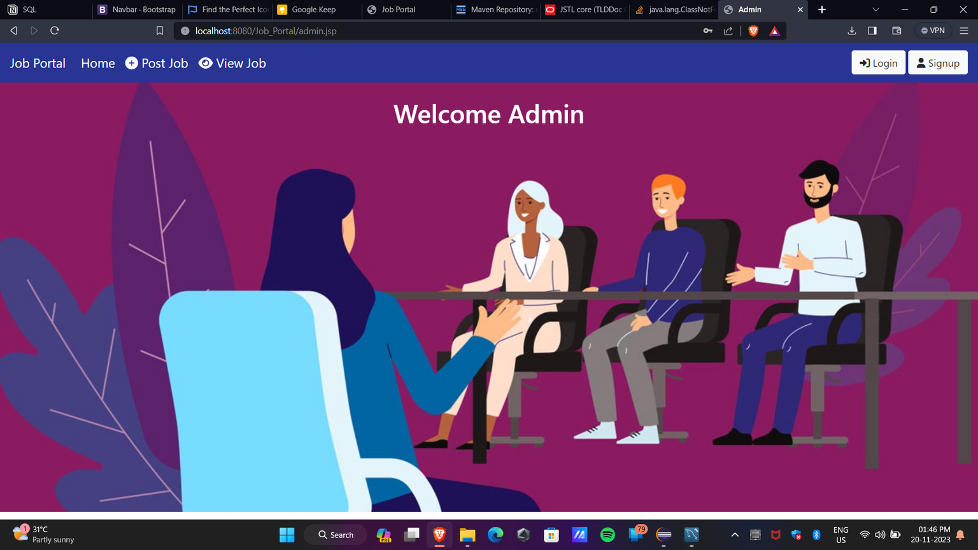
USER INTERFACE

Slide 7

Submission Github
https://github.com/ajithakdev/Jobsearch-App.git

Slide 8


